Slide 1


Cybercrime in Russia: Trends and issues
Robert Lipovsky, Aleksandr Matrosov and Dmitry Volkov

Slide 2

This presentation is confidential and not subject to public disclosure

Slide 3
Agenda
General cybercrime trends in 2010
Most prevalent threats and incidents
Reasons for the incidents’ growth
Evolution of the cash-out scheme
Legal evasions and loopholes
Successful criminal prosecutions
Analysis of malware used in the attacks

Slide 4

Group-IB
First and only public company in Russia engaged in digital crime investigation and computer forensics consulting
Established in 2003
Assistance to law enforcement authorities on particularly difficult cases
Partners and researchers in 48 countries
Russian HoneyPot-Net project
24/7 monitoring and incident response

Slide 5

Cybercrime in 2010
Global computer crime market turnover at
7 billion dollars
Share of cybercriminals living in Russia estimated at 1.3 billion dollars ~19% of global crime
Cybercriminals from Russian speaking countries: 2.5 billion dollars ~36% of global crime
*research report "The Russian cybercrime market in 2010: status and trends”
http://www.group-ib.ru/wp-content/uploads/2011/04/Group-IB_Report_Russian-cybercrime-market_2010_eng.pdf

Slide 6
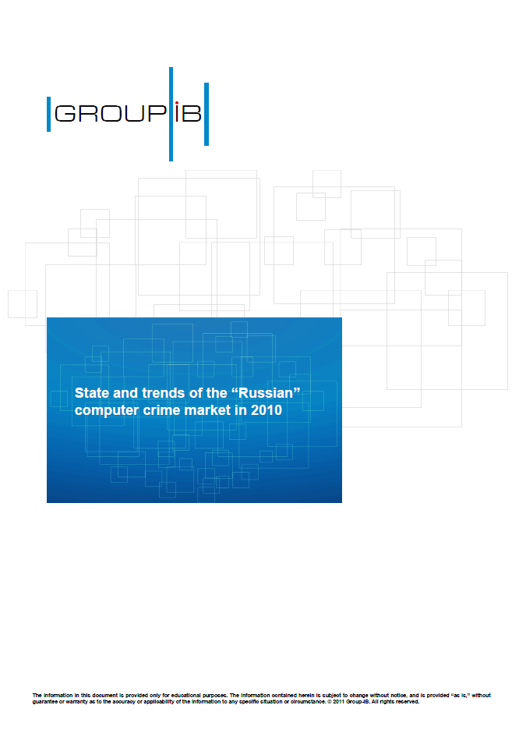
Most prevalent threats and incidents
Fraud targeted at Russian banks and payment systems
SMS fraud using premium numbers(“winlockers”/LockScreen trojans)
DDoS attacks – Growth in number and in power
Unauthorized access to sensitive corporate information
*research report "The Russian cybercrime market in 2010: status and trends”
http://www.group-ib.ru/wp-content/uploads/2011/04/Group-IB_Report_Russian-cybercrime-market_2010_eng.pdf

Slide 7
Incident statistics by Group-IB forensic lab
Share of cybercriminals living in Russia
estimated to increase to
1.8 billion dollars in 2011
(vs. 1.3 billion in 2010)
unauthorized
access
brand attacks
DDoS
bank fraud
SMS fraud (LockScreens) not shown because the numbers are disproportionally greater
Notes:
ASK Pierre Marc – text in red

Slide 8
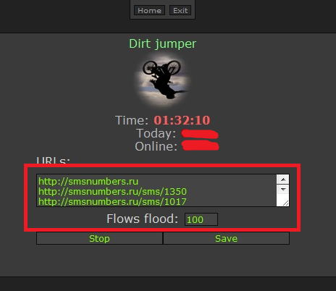
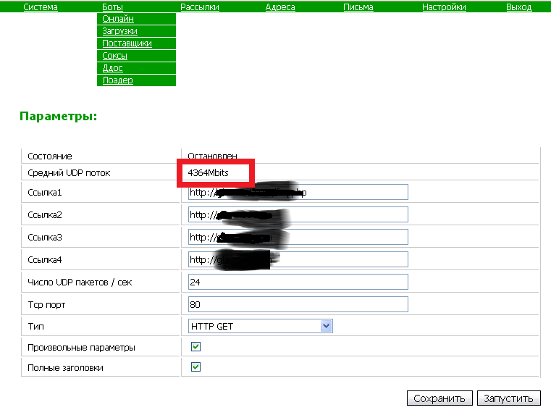
DDoS attacks: Growth in number and power
attackers DDoS bank if transaction exceeds 150 000 $
most powerful attack 100 Gb/sec
(victims: UkrTelecom, Yandex, EvoSwitch
but real target was a dating affiliate program)

Slide 9
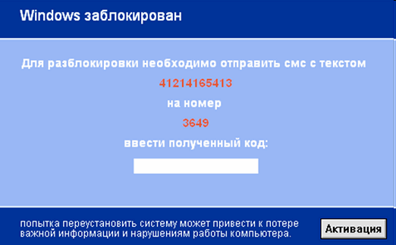
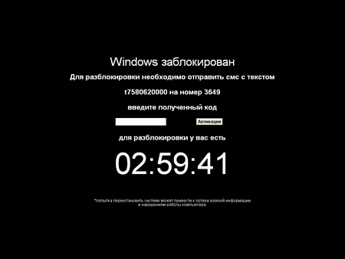
SMS fraud using premium numbers: LockScreen malware
If your country is affected, please, contact us for information
Group-IB developed a case-tutorial for this type of investigation

Slide 10
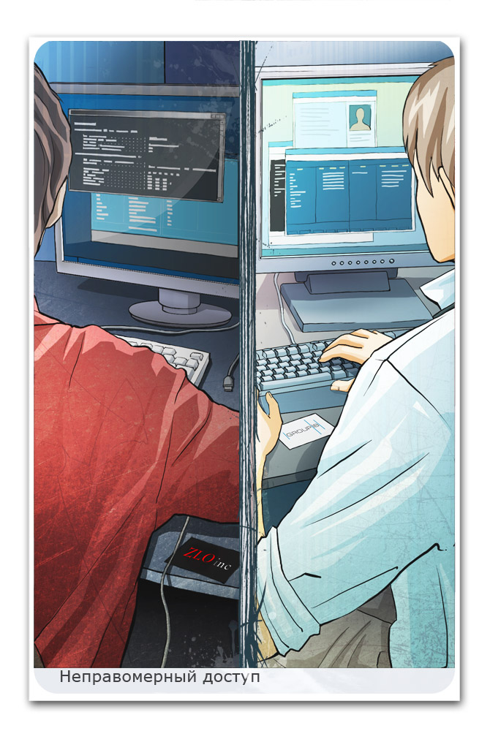
Reasons for the incidents’ growth
Legal evasions and loopholes
Low cost of services in Russia
Lack of legal jobs for young IT-specialists
High profit and minimum investments from cybercrime
Low information security vs. high cybercrime groups activities
Shift of attack targets back to USSR :)

Slide 11
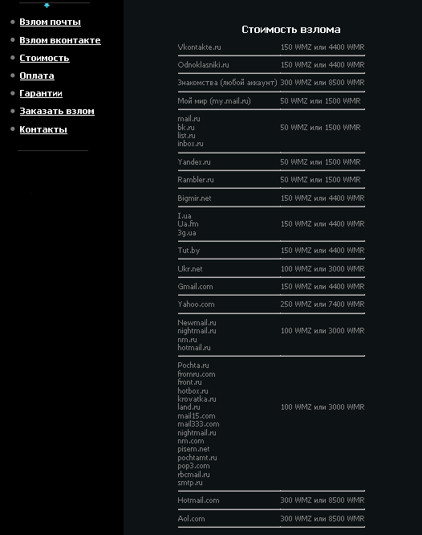
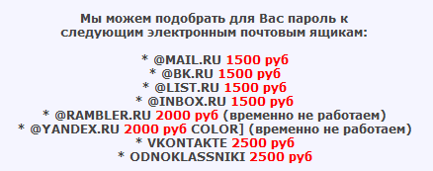
Cost of services in Russia
Hacking of a website: from $50
Guaranteed hack of a mailbox (Yandex, Mail, Rambler, Gmail): from $45
Mobile phone bug: from 5000$
SMS service bug: from 1000$
Massive distribution of Trojan and spyware: from 20$ (1000 users)
Spam services:
400,000 companies - $55
1,800,000 private persons - $100
90,000 companies in St. Petersburg - $30
450,000 private persons in Ukraine - $50
6,000,000 private persons in Russia - $150
4,000,000 emails on @mail.ru - $200

Slide 12
Evolution of the Cash-out scheme
For amounts up to 40k $
Fraudster-thief
Region unknown
«Drop master» returns part of money to fraudster by himself in cash if he is in one cybercrime group with Fraudster or any way of non-cash payment if they are not in one cybercrime group.
Credit cards, drops and so on can be used in any region.
Infects computer and get unauthorized control of it
Payment system, for opened account
Region 2
User 1 Payment system (victim)
Region 1
Virtual account (cash-box) of the client
Fraudster generate fake (micro) payment
Payments accepts, because payment systems detect them as legal payments
«Drop master» keeps cash-out service
Region unknown
Supplier of e-transfer or another Payment system
«Drop» – real or unreal person. Can be from any region or any country.
«Drop’s» Virtual account
Money cash-out or further transfer in different ways
Bank or Virtual of any type formed on any persons in any region
Схема подготовлена 40-м отделом Управления «К» МВД России. Тел. (495) 623-33-29. © 2011 г.
Scheme was prepared by 40-th division of Department «K» MVD Russia. Tel. (495) 623-33-29. © 2011 г.

Slide 13
Evolution of the Cash-out scheme
For amounts 40-200k $
«Drop master» returns part of money to fraudster by himself in cash if he is in one cybercrime group with Fraudster or any way of non-cash payment if they are not in one cybercrime group.
Credit cards, drops and so on can be used in any region.
Fraudster-thief
Region unknown
Infects computer and get unauthorized control of it
Bank, with opened account
Region 1 or 2
«Drop master» keeps cash-out service.
Organizing cash-out process and controls, prepares legal companies, credit cards and drop people.
Region unknown
Bank client
(victim)
Region 1
Fraudster generate fake payment
Client’s bank account
Payments accepts, because bank systems detect them as legal payments
Managing with bank account by himself or by other persons
Bank of «Drop» – Registered company Region 3
Банковский счет «дропа»
Bank account
Money cash-out or further transfer in different ways
Different type accounts for private persons or registered companies in different regions
“Registered Company” can be one day company or real legal company
Banks «credit cards» accounts for private persons, bank accounts for registered companies, virtual accounts in different payment systems and so on Can be in any region
Схема подготовлена 40-м отделом Управления «К» МВД России. Тел. (495) 623-33-29. © 2011 г.
Scheme was prepared by 40-th division of Department «K» MVD Russia. Tel. (495) 623-33-29. © 2011 г.

Slide 14
Evolution of the Cash-out scheme
For amounts over 200k $
Fraudster-thief
Region unknown
Sell stolen accounts
«Loader» (thief)
Region unknown
«Drop master» returns part of money to fraudster. Several «Drop masters» are involved -100% signature of non-cash transfers via credit cards, WM, drops and so on. In any region
Infects computer and get unauthorized control of it
«Loader» rent «dedicated servers», installs online bank software and uses stolen accounts, that he bought.
Bank client
(victim)
Region 1
Bank, with opened account
Region 1 or 2
««Drop master» keeps cash-out service.
Organizing cash-out process and controls, prepares legal companies. Manage operations by himself or other persons. Different regions
Client’s bank account
Infected computer («dedicated server») Region 1 or any other
«Loader» generates payment documents
Payments accepts, because bank systems detect them as legal payments
Bank of the «Drop» – Registered company Region 3
Bank of the «Drop» – Registered company Region 4
Virtual account in digital payment system
Region 5
Accounts are opened for different persons in different regions by three different «Drop masters»
Credit card account of the «Drop» private person
Bank account of the «Drop» Registered company
Different type accounts for private persons or registered companies in different regions
Virtual account in Supplier of e-transfer Region 6
Bank and virtual accounts in opened for different private persons or registered companies in different regions

Slide 15
Chapter 28 of the Penal Code
Article 272. Illegal Access to Computer Information | Article 273. Development, Use and Spreading of Malicious Software | Article 274. Violation of Rules for the Operation of Computers, Computer Systems or Their Networks
Criminal responsibility
Maximum fine of 300 000 RUB or imprisonment for up to 5 years. | Imprisonment for up to 7 years | Imprisonment for up to 4 years

Slide 16

Legislative initiatives
The Committee against Cyber-Crime at the Russian Association of Electronic Communication (RAEC)
Improvement of Russian legislation in the field of cyber crimes
Anti-SPAM legislation
Support against online child pornography

Slide 17
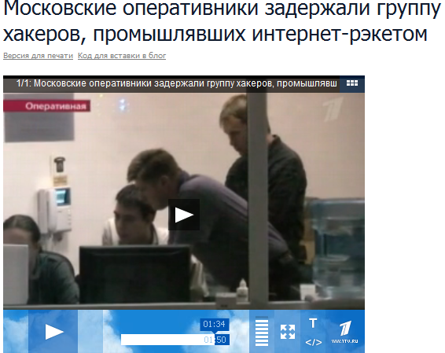


Successful criminal prosecutions
Group-IB, Economic Crimes Division and Dept K MVD busted a group of cybercriminals who developed and spread the “LockScreen” malware
10 cybercriminals have been arrested
Notes:
CHANGE: BUSTED

Slide 18
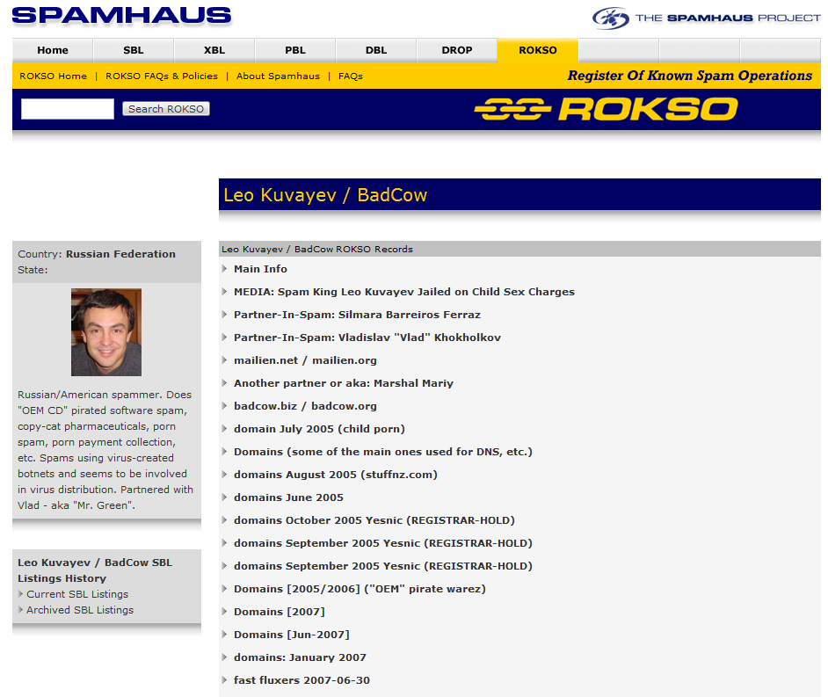
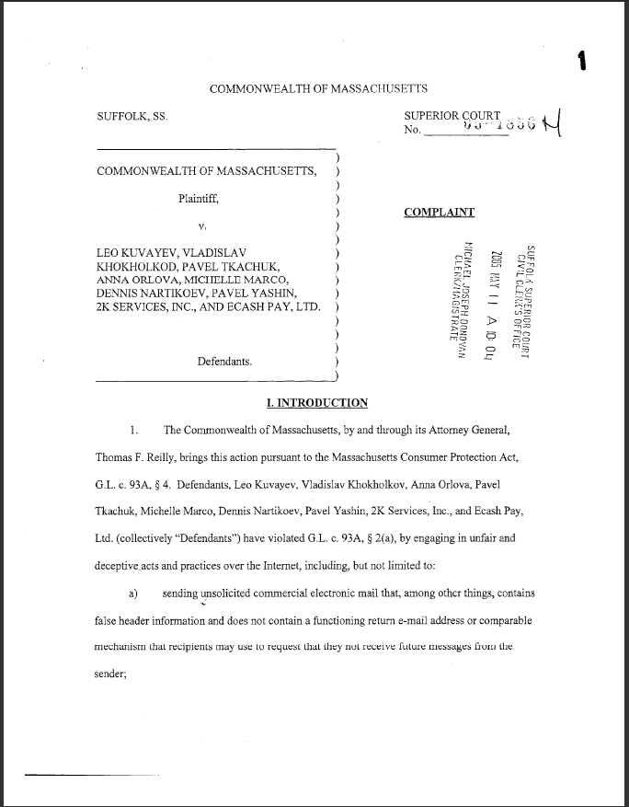
Successful criminal prosecutions
Leo Kuvaev case (BadCow)

Slide 19
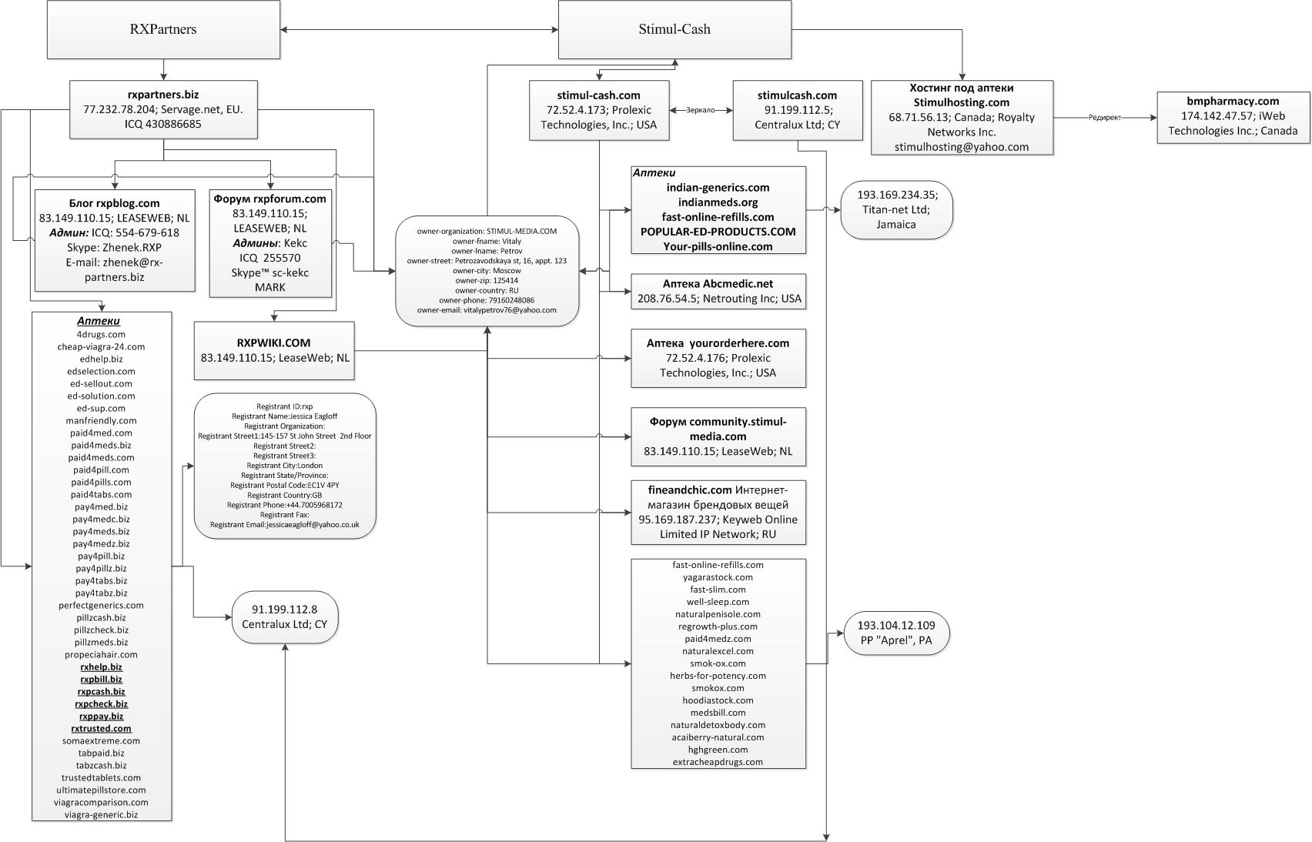
Successful criminal prosecutions
Leo Kuvaev case (BadCow)

Slide 20

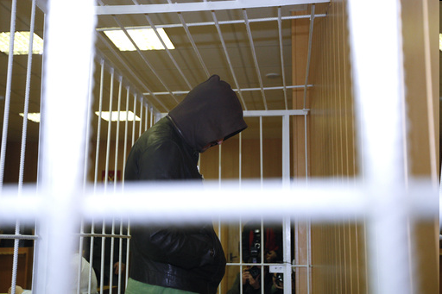
Successful criminal prosecutions
DDoS case (Cxim)
Provided DDoS as a service
Arrested for DDoS against Russian banks
8 months in jail

Slide 21
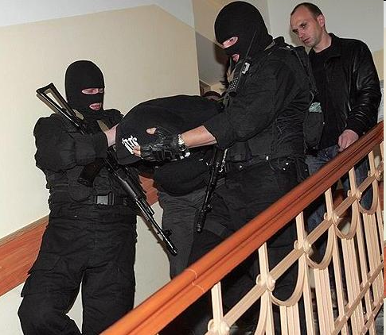
Successful criminal prosecutions
Russian bank-fraud case
Group #1
stole 600 000$ in a single transaction
case in court
used Win32/Sheldor
Group #2
stole 832 000$ (over 1 month)
case in court
used phishing sites (hosted on Gogax)

Slide 22
Interesting facts about Russian bank fraud
1
Mass distribution since 2009
2
Six cybercrime groups attacking Russian banks
3
Maximum amount stolen at one time from single bank account: 14 814 820$

Slide 23
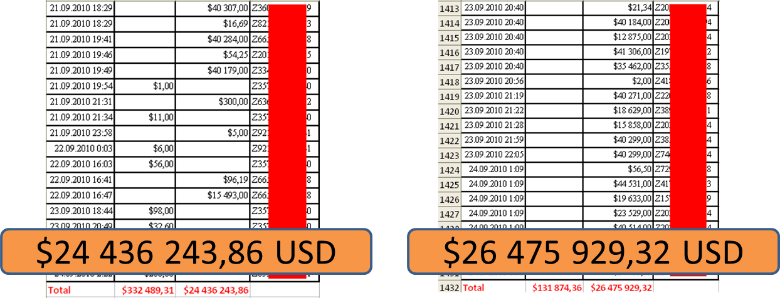
Interesting facts about Russian bank fraud
These guys are still free!

Slide 24
Analysis of malware used in the attacks on Russian Internet Banking systems

Slide 25
Overview
2010: year of attacks on Russian banks
number of incidents has more than doubled compared to 2009*
Over 95%* of incidents involve banking trojans
Malware tailored to Russian banks and payment systems
However!
Can (and IS) used in other countries as well
*research report "The Russian cybercrime market in 2010: status and trends”
http://www.group-ib.ru/wp-content/uploads/2011/04/Group-IB_Report_Russian-cybercrime-market_2010_eng.pdf

Slide 26
Malware family share by incidents (%)*
(in the last 6 months)
*as investigated by Group-IB

Slide 27
Most prevalent banking malware in Russia
Malware Family | Description
Win32/RDPdoor | Backdoor; uses MS Remote Desktop; botnet
Win32/Sheldor | Backdoor; abuses the TeamViewer application; botnet
Win32/Carberp | Universal trojan with modules for targeted attack on Russian banks; botnet
Win32/Hodprot | Downloader; installs other malware modules; strong encryption of its C&C protocol
Win32/Qhost | Malware that modifies the hosts file

Slide 28
Win32/RDPdoor
Notes:
Win32/RDPdoor or how to steal money using Microsoft Remote Desktop?

Slide 29
Stealing money using MS Remote Desktop…
Win32/RDPdoor overview
Appearance: First samples detected in April 2010
Cost: ~ 2.000$
Key feature: Abuses components of Thinsoft BeTwin for RDP
Most prevalent banking trojan in Russia
Bypassing advanced security mechanisms (Smartcards, etc.)
Notes:
TITLE: DO WE WANT THE FIRST SENTENCE???
For 2000 bucks you get access to an admin panel and bot builder. If you pay extra you get support – meaning periodic updates - undetected variants – repacked for bypassing AV detection
In Russia Win32/RDPdoor is the most common banking trojan
has been linked to many real incidents of money stolen from clients’ banking systems
2 advantages of using RDP: 1.signed components of legitimate software – avoiding suspicion 2.simultaneous connections

Slide 30

Win32/RDPdoor detection statistics by country
Cloud data from ThreatSense.Net
April 2010 – March 2011
%
Notes:
Russia, Ukraine & Kazakhstan have similar banking systems

Slide 31
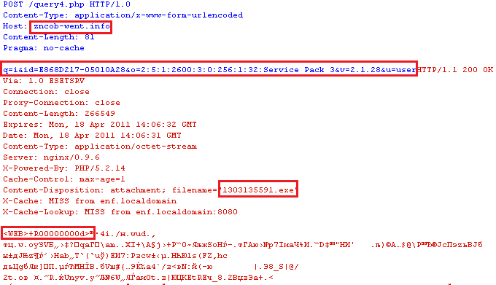
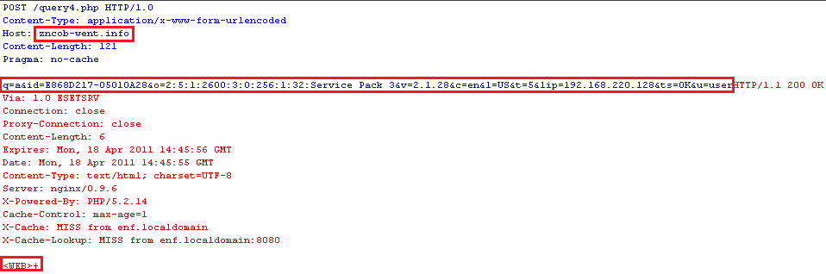
Win32/RDPdoor installation
infected
computer
Win32/RDPdoor C&C
run dropper and send system information
1
authentication on C&C and provide Thinsoft BeTwin for installation
2
send status information
3
Notes:
Title formerly: How does it works?
First HTTP POST = step 1: sends bot id, system info, user/admin
then server replies – step 2 = 131...exe is Thinsoft component
Second HTTP Post = step 3: sends status OK, IP address..etc.

Slide 32
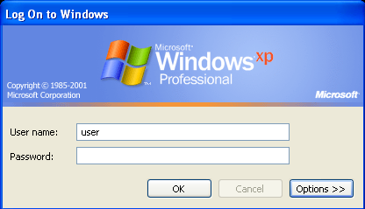
Stealing authentication data
Install GINA extension DLL
Display fake logon screen
Capture user name & password
Send to C&C
Notes:
GINA = Graphical Identification and Authentication
The attacker can then use these credentials to access the infected system…
(XP doesn’t have Terminal services – Thanks to BeTwin component user doesn’t get logged out.)

Slide 33
Win32/RDPdoor bot commands
Bot Command | Description
“P” | change password for BeTwin terminal session
“B” | reinstall BeTwinServiceXP module
“S” | administration of BeTwin terminal session
“R” | install BeTwinServiceXP module
“T” | BeTwin backconnection initialization
“U” | update main modules and configuration
Notes:
Point out:
R: remember R from before?
T: BeTwin backconnection initialization used to bypass NAT
U: update…next slide

Slide 34
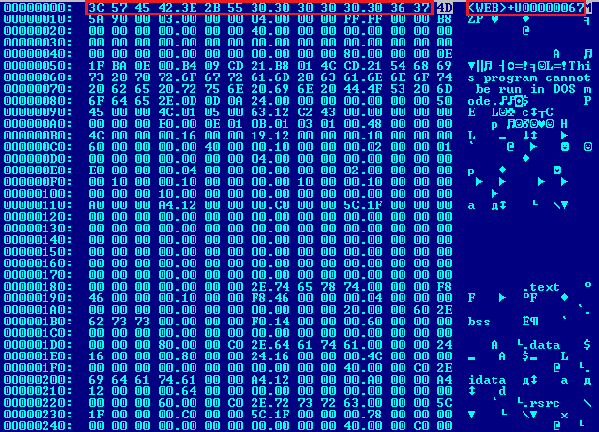
Win32/RDPdoor updating
New dropper with a new configuration embedded is received after ‘U’ command
Notes:
Former title: Win32/Agent.SGJ after executing update command get new dropper with embedded new configuration

Slide 35
Win32/Sheldor
Notes:
Win32/Sheldor – it’s new effective backdoor for stealing your money

Slide 36
Win32/Sheldor overview
Appearance: First samples detected in June 2010
Cost: ~ 2.500$
Key feature: Abuses the TeamViewer application for remote access
Using the TeamViewer cloud adds another level of anonymity
Notes:
Since 2010
first samples were detected as June 2010
Spread on cybercrime market
admin panel + bot builder average price in cybercrime market is 2.500$
Have low detection rate for new modifications
use some tricks and signing legal components of TeamViewer for bypass AV detections
Can used for targeted attacks
well suited for targeted attacks to hiddenly steal critical information
LIKE RDPdoor
Used in several targeted attacks on main companies
have real incidents with client-banks systems in main Russian companies
Bypassing secure storage of key information
controlles all actions on infected PC and all connected external devices (smartcards, flash cards …)
Use Teamviewer cloud for remote connections
all connections to infected PC going over Teamviewer cloud and adds another level of anonymity
Use legal software for remote connections
to access remote systems uses signed components of TeamViewer

Slide 37
Win32/Sheldor detection statistics by country
Cloud data from ThreatSense.Net
April 2010 – March 2011
Notes:
Similar prevalence: Top 3 as before - Russia, Ukraine & Kazakhstan have similar banking systems

Slide 38
Win32/Sheldor and TeamViewer in action
Request cloud ID
Set cloud ID
Send ID to C&C
Malicious connection
TeamViewer
cloud
1
2
infected
computer
4
Win32/Sheldor
C&C
3
GET /getinfo.php?id=414%20034%20883&pwd=6655&stat=1

Slide 39
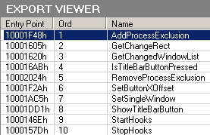
Under the hood: DLL hooking
TeamViewer.exe
TV.dll
(proxy DLL)
TS.dll
(original TS.dll)
Notes:
The functionality of the malicious DLL:
Communicate with C&C
Process bot commands
Mention: new version doesn’t use modified DLL, but makes in-memory hooks

Slide 40
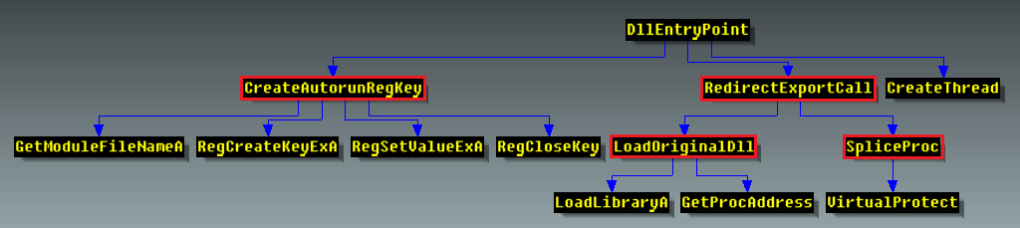
Malicious DLL call graph

Slide 41
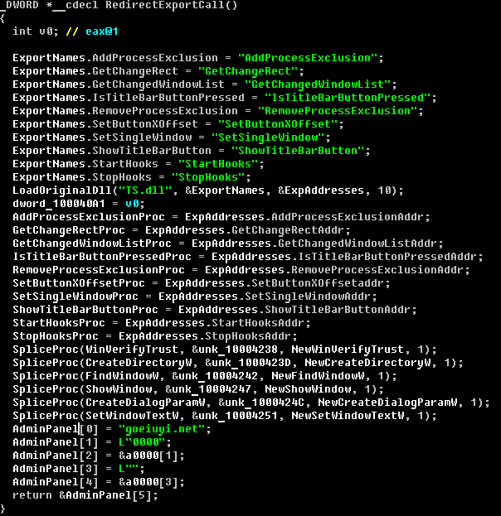
Malicious DLL decompilation
Functions for calling
from original TS.dll
Load original TS.dll
Hook functions
C&C URL

Slide 42
Win32/Sheldor bot commands
Bot Command | Description
exec | download and ShellExecute/CreateThread additional module
monitor_off | send command “stop monitoring” to C&C
monitor_on | send command “start monitoring” to C&C
power_off | ExitWindowsEx(EWX_POWEROFF, SHTDN_REASON_MAJOR_OPERATINGSYSTEM)
shutdown | ExitWindowsEx(EWX_REBOOT, SHTDN_REASON_MAJOR_OPERATINGSYSTEM)
killbot | delete all files, directories and registry keys
Notes:
Mention: exec, kill

Slide 43
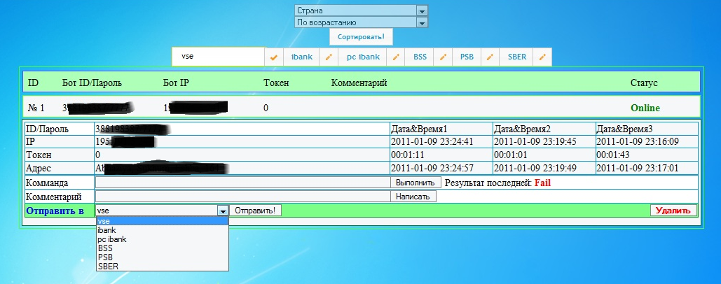
Sheldor C&C panel
Notes:
Execute command

Slide 44
Successful criminal prosecutions
Russian bank-fraud case
Group #1
stole 600 000$ in a single transaction
case in court
used Win32/Sheldor
Group #2
stole 832 000$ (over 1 month)
case in court
used phishing sites (hosted on Gogax)

Slide 45
Win32/Carberp
Notes:
Win32/Carberp is the new cybercrime king of Russia by information stealing
SAY: king of Russian information stealing trojans

Slide 46
Win32/Carberp overview
Appearance: First samples detected in February 2010
Cost: ~ 9.000$
Key feature: Advanced information stealing trojan with plug-ins
Customizable to specific banks
Man-in-the-browser attacks (IE, FireFox)
Grand Theft: Real cases with millions of $$$ stolen
Notes:
first samples were detected as February 2010
Average Cost of Admin panel + bot builder on the cybercrime market is 9.000$ (depending on the modules included and support time)
NOT SOLD TO EVERYONE, ONLY TRUSTED CUSTOMERS, distributed through closed FORUMS
“automated” compared to previous two
One C&C can collect information from thousands payment accounts (from real cases we have numbers with millions $$$)
Targeting on steal money from small business
steals money from special client-bank soft, which spread small business segment in Russia (has bad information security infrastructure)
IE: WinInet.DLL
Hooks SSL3.DLL FireFox DLL for intercepting SSL communication <<SAY

Slide 47
Win32/Carberp detection statistics by country
Cloud data from ThreatSense.Net
April 2010 – March 2011

Slide 48
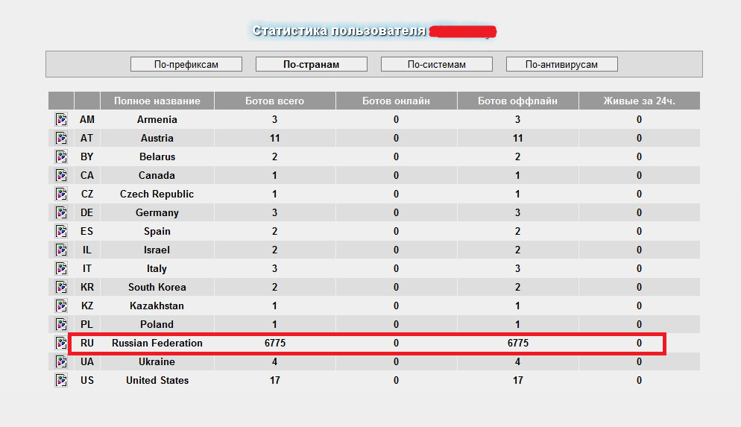
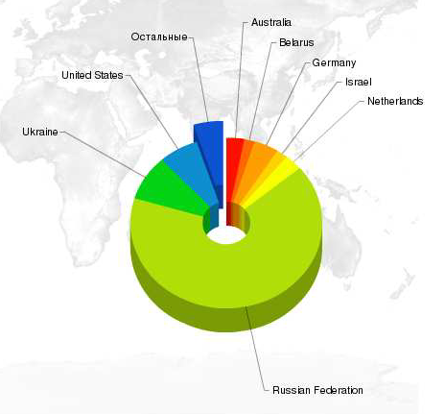
C&C panel: Bots by country
Notes:
from takedown C&C panel

Slide 49
Win32/Carberp detections over time in Russia
Cloud data from ThreatSense.Net
April 2010 – March 2011
Notes:
Between November and December: C&C shutdown by Group-IB investigators << ASK DMITRY

Slide 50
Win32/Carberp bot commands
Bot Command | Description
update | Download new version of Carberp
dexec/download | Download and execute PE-file
kill_bot/killuser | Delete trojan from the system Delete user's Windows account (latest version)
startsb/loaddll | Download DLL and load into trojan's memory address space
grabber | Grab HTML form data and send to C&C
Notes:
in latest version, deletes user's Windows account >> This makes forensic analysis harder

Slide 51
Win32/Carberp self-protection
Self-protect method | Win32/Carberp.W | Win32/Carberp.X
Bypassing AV-emulators | many calls of GUI WinAPI functions | many calls of GUI WinAPI functions
Code injection method | ZwResumeThread() | ZwQueueApcThread()
Command and string encryption | ☒ | custom encryption algorithm
Bot authentication on C&C | ☒ | file with authentication data stored on infected PC
API function encryption | custom encryption algorithm | custom encryption algorithm
Detection of AV hooks | comparison of the first original bytes | comparison of the first original bytes
Bypassing static AV signatures | adds random junk bytes to dropped files | adds random junk bytes to dropped files
Hiding in the system | hook system functions | hook system functions
Notes:
Here’s an overview of the techniques Carberp uses for self-protection…it also shows the additions made in newer versions of the malware

Slide 52

Win32/Carberp distribution channels
Direct distribution
Distribution via partners
control
panel
affiliate ID
“partnerka”
(affiliate program)
exploit pack
BlackHat SEO
Infected Blogs
etc
Notes:
Difference between two distribution channels:
They pay only for traffic
They pay per installation
BLACK HAT SEO, INFECT BLOGs - REDIRECT
Via drive-by downloads
Many incidents using the IMPACT exploit pack used in closed groups

Slide 53
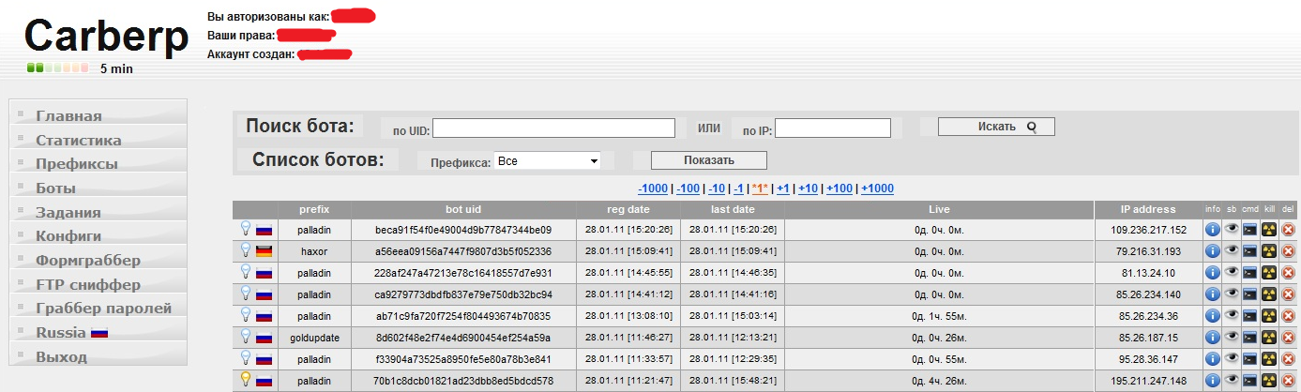
Win32/Carberp botnet control panel
Notes:
Point out:
The Carberp NAME
Prefix
LIVE column – you can see that this C&C has been taken down
Commands
Menu – advanced command&control center

Slide 54
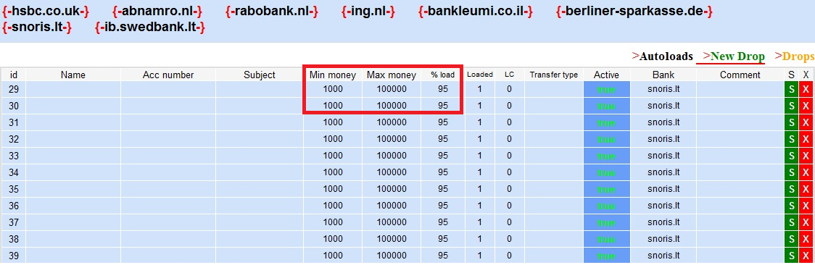
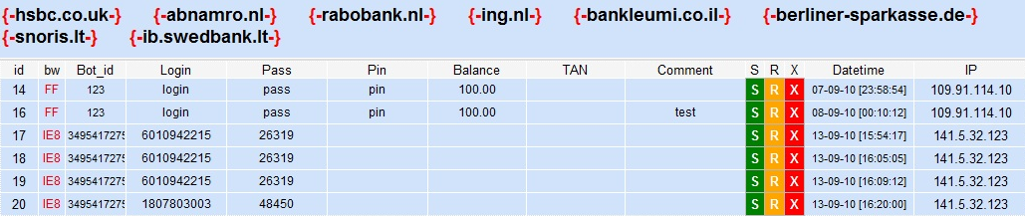
Win32/Carberp control panel – Bank settings
Notes:
Mention:
Transaction limits to avoid suspicion
Rob Not only Russian banks – also HSBC UK, Netherlands, Germany, Latvia

Slide 55
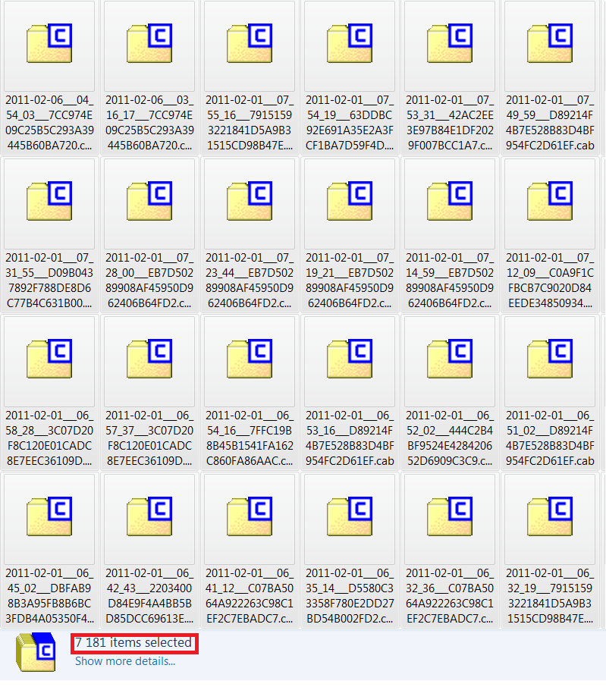

Cab-files with stolen data
Notes:
The takedowns of the C&C servers have yielded lots of stolen sensitive data. In this case over 7000 archives with stolen sensitive data have been recovered

Slide 56
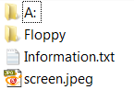
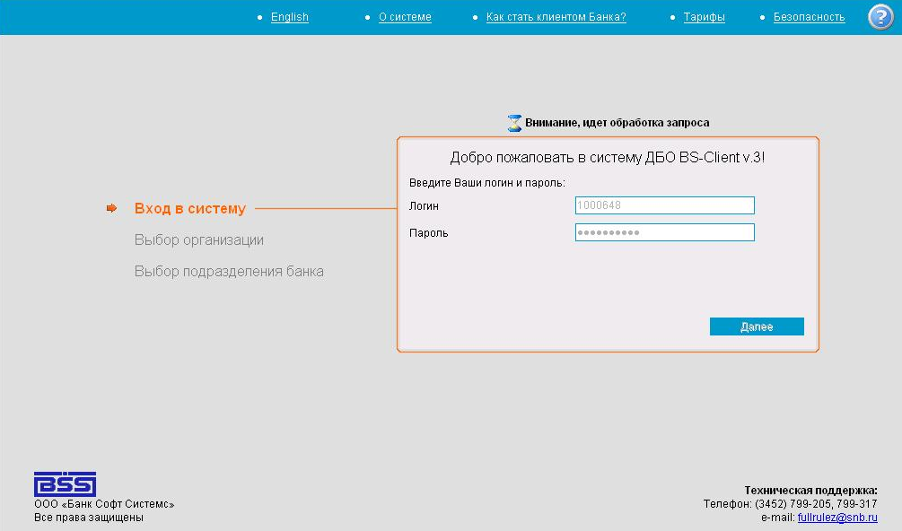
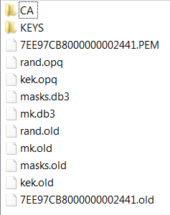
Stolen data: BS-Client IB system
Notes:
BS-client is internet banking software

Slide 57
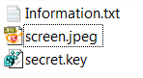
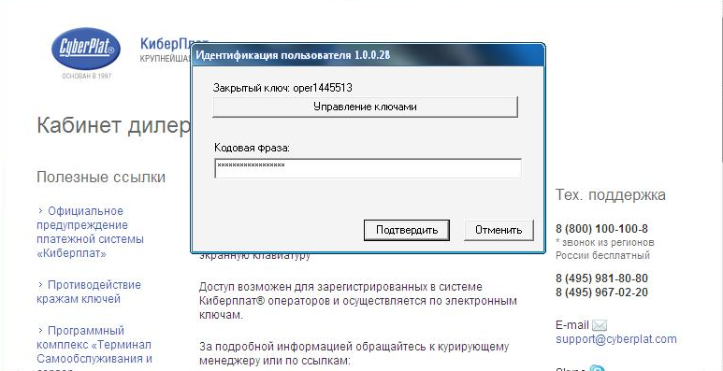
Stolen data: CyberPlat payment system
Notes:
CyberPlat payment system – Russian PayPal

Slide 58
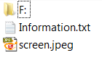
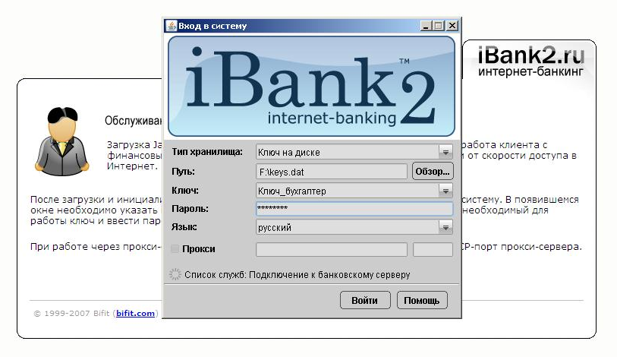
Stolen data: iBank IB system
Notes:
iBank internet banking system

Slide 59
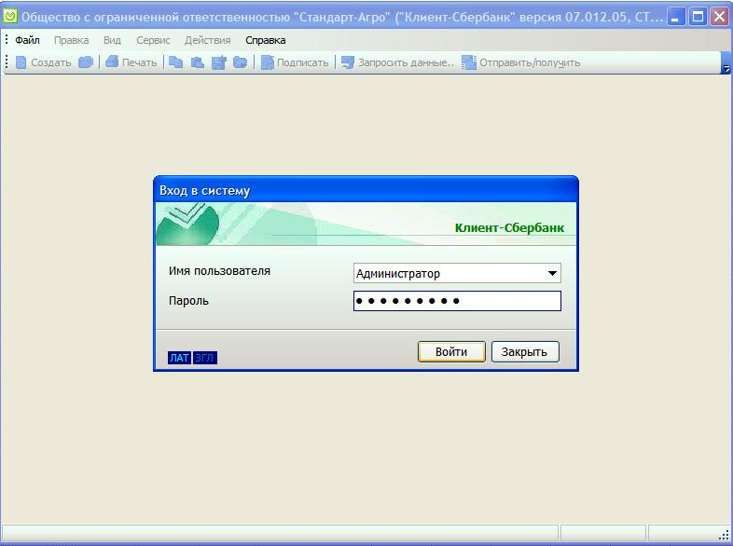
Stolen data: SberBank IB
Notes:
SberBank – Major Russian bank

Slide 60
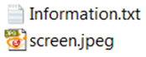
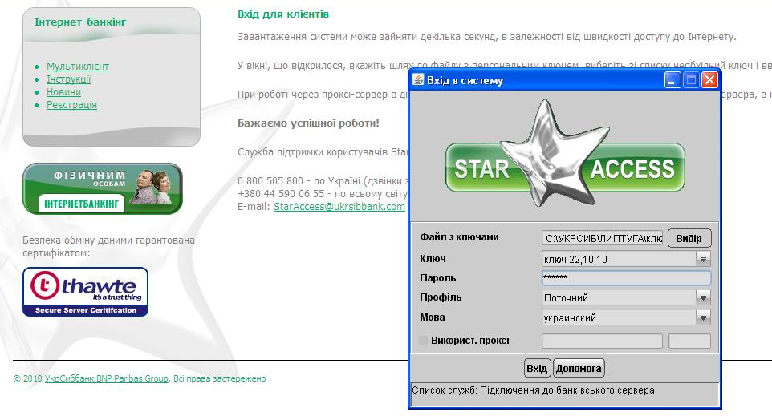
Stolen data: UkrSibBank IB
Notes:
UkrSibBank internet banking system

Slide 61
Win32/Carberp Summary
Cybercrime kit using multiple stealing techniques
Since early 2010 targeting other regions too
Several independent cybercrime groups involved
Joint investigation of Russian police, Group-IB and ESET
Notes:
Just a couple of additional facts on Carberp:
Cybercrime kit with multiple stealing techniques
a number of vectors to attack the Russian banks and payment systems have not previously encountered in other trojans
Since early 2010 targeting other regions too
now we are seeing an increase of sales in other regions of this cybercrime kit, but the number of incidents in Russia remains in first place
Several independent cybercrime groups involved
The analysed Carberp samples show us that several independent Russian cybercrime groups are involved in its development
Joint investigation of Russian police, Group-IB and ESET
The Carberp cybercrime groups are under investigation which is a joint operation with the participation of the Russian police supported by researchers from Group-IB and ESET

Slide 62
Summary
 | Win32/RDPdoor | Win32/Sheldor | Win32/Carberp
First appearance | April 2010 | June 2010 | February 2010
Cost | 2000 $ | 2500 $ | 9000 $
Prevalence | Russia, Ukraine, Kazakhstan | Russia, Ukraine, Kazakhstan | Russia, Ukraine, Spain, USA
Remote Access | RDP via ThinSoft BeTwin | Via TeamViewer | Via plug-ins
Information stealing | manually | manually | automated
Plug-ins | ☒ | ☒ | ☑
Complexity |  |  | 
Botnet | ☑ | ☑ | ☑
Notes:
COOPERATION BETWEEN MALWARE FAMILies: We’ve seen cases where Carberp downloaded Sheldor and vice-versa

Slide 63
Conclusion
Banks in other countries becoming new targets of Russian cybercrime groups
Attackers respond to new security measures with new methods to bypass them
Cybercriminals use stolen money to stay out of jail
Disabling C&C servers not enough to stop them
Only way of fighting them is by cooperation

Slide 64

Questions

Slide 65
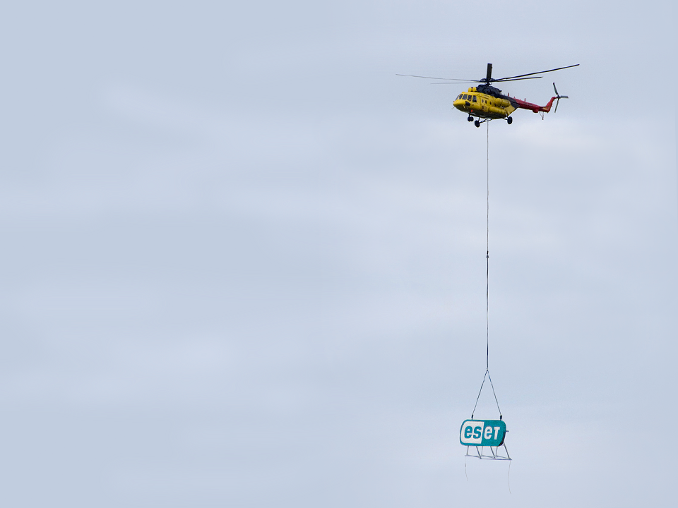
Thank you for your attention ;)
Robert Lipovsky, ESET
lipovsky@eset.sk
Aleksandr Matrosov, ESET
matrosov@eset.sk
@matrosov
Dmitry Volkov, Group-IB
volkov@group-ib.ru
@groupib

